Slide 1
Electronic Trade board
ETB

Slide 2
What exactly is it?
Web based system for flight attendants to trade, drop and pick up sequences
Flight attendant to flight attendant
No impact on open time
Accessed through Crew Portal
Trade vacation days
Trade reserve days off (Flex days/Golden days)
Notes:
ETB allows flight attendants to trade, drop, and pickup sequences, trade vacation days (for LAA, vacation blocks until PBS) and reserve days off
Operates in real time
Replaces HIBOARD for LAA
Does not interact with open time
Accessible anywhere you have an internet or data connection….personal or work computer, tablet, or cell phone
Look and feel is similar to Jetnet and Crew Portal
Should feel familiar to flight attendants
#

Slide 3
Features
LUS | LAA
Added a calendar | No more complex Sabre entries
Ability to trade reserve days off | ETB will process the transaction
Updated sequence display | More search criteria
 | Ability to post a pickup request
Notes:
For LUS some of the enhancements include:
Added a calendar view
Ability to trade RSV days off
Updated sequence display
For LAA:
No need to remember long strings of computer entries
HT/emp/emp
HTS/A/seq/date
HTS/B/seq/date
HTMD
HZ
Easier, more intuitive to use
ETB also processes the transactions, currently you must search in HIBOARD and then exit HIBOARD and make the trip trade entries in Sabre
Greatly expanded search criteria (20 vs 10)
Loss of TT services may be viewed as a negative
#

Slide 4
Features
ETB does not process transactions during the TTS run
Avoids conflicts with TTS
You can still search and post
Transactions are queued and processed automatically after the nightly TTS run
While PBS is processing, ETB will reject transactions that involve the last 3 days of the current month
Lowers the number of month to month conflicts
Last 3 days are frozen ONLY during PBS bid processing
15th to 20th
Notes:
TTS or Trip Trade System allows flight attendants to pick up, drop and trade sequences with open time and other flight attendants
ETB will not process transactions while TTS is running to avoid conflicts
FA can still search and create posts
Transactions are queued and processed when ETB reopens
Transactions are processed in the order received
Some may view ETB closing as a negative
At PBS bases, during the bid run, ETB will reject any transaction that touches the last 3 days of the current month
#

Slide 5
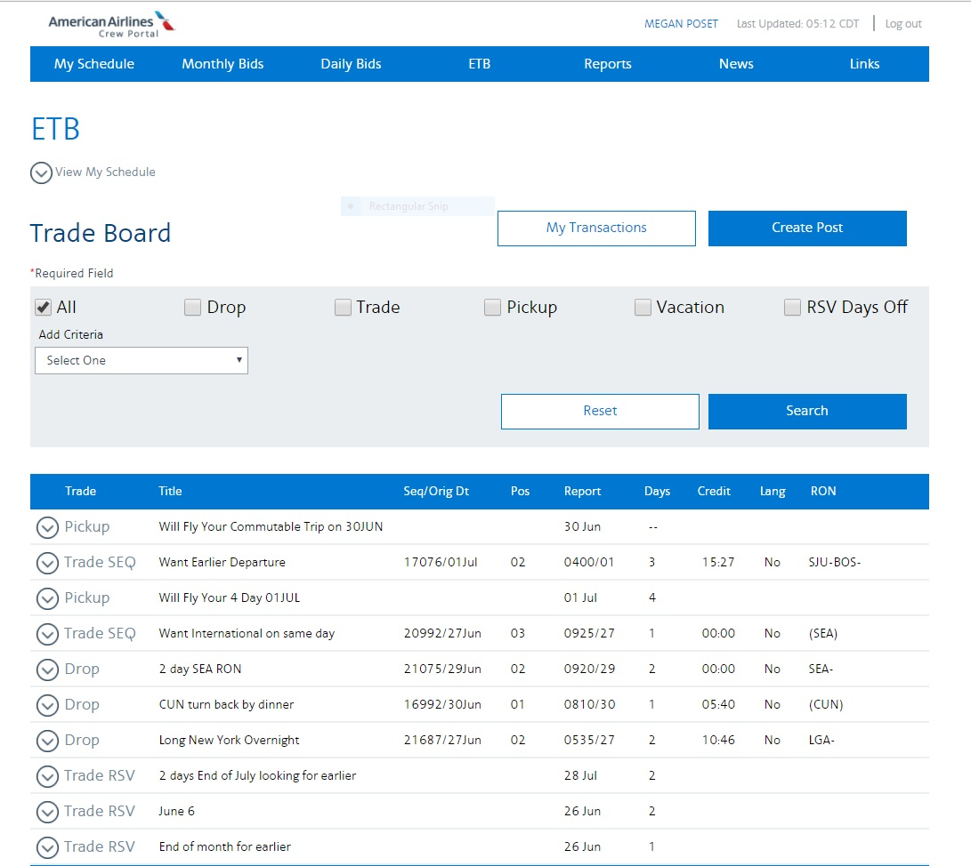
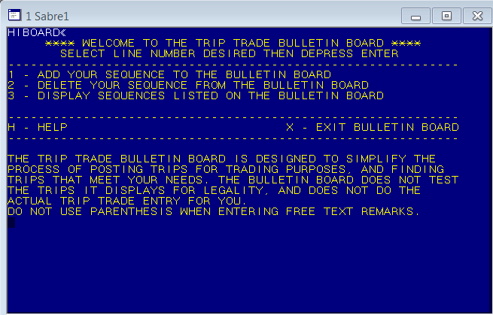
Improved user interface
Jane Stew
Notes:
AUTO
LAA will be moving from using native SABRE, long strings of computer formats and a menu driven HIBOARD to a modern trip trading platform.
#

Slide 6
Terminology
RON – Remain Over Night, (layover)
Report/Release – sign in/debrief
Time Display Preference
Default is base
Can be changed
Public posts
Private posts
Crew posts
Not accepting trade requests
Notes:
A few terms that may be new, or need explanation
RON stands for Remain Over Night or layover
Times in ETB are listed in a Report/Release format, no longer as Departure and Arrival times. Because sign in requirements and debrief are specific to the type of flying, easier for FA to figure out
Time Display Preference will be important to emphasize, you’ll see an example of how to change that in a later slide
Defaults to BASE
If changed in ETB it will change in all applications and on all devices
Change by clicking your name at the top of the page
BASE all times are listed in home base time
STATION all times are listed in local station time
Public posts can be seen by anyone looking at ETB
Private posts are directly between individuals
Crew posts are new for LAA. Requests are sent to each FA on a specific sequence
Changing your sequence to NOT ACCEPTING TRADE REQUESTS is similar to putting a do not disturb sign on that sequence
#

Slide 7
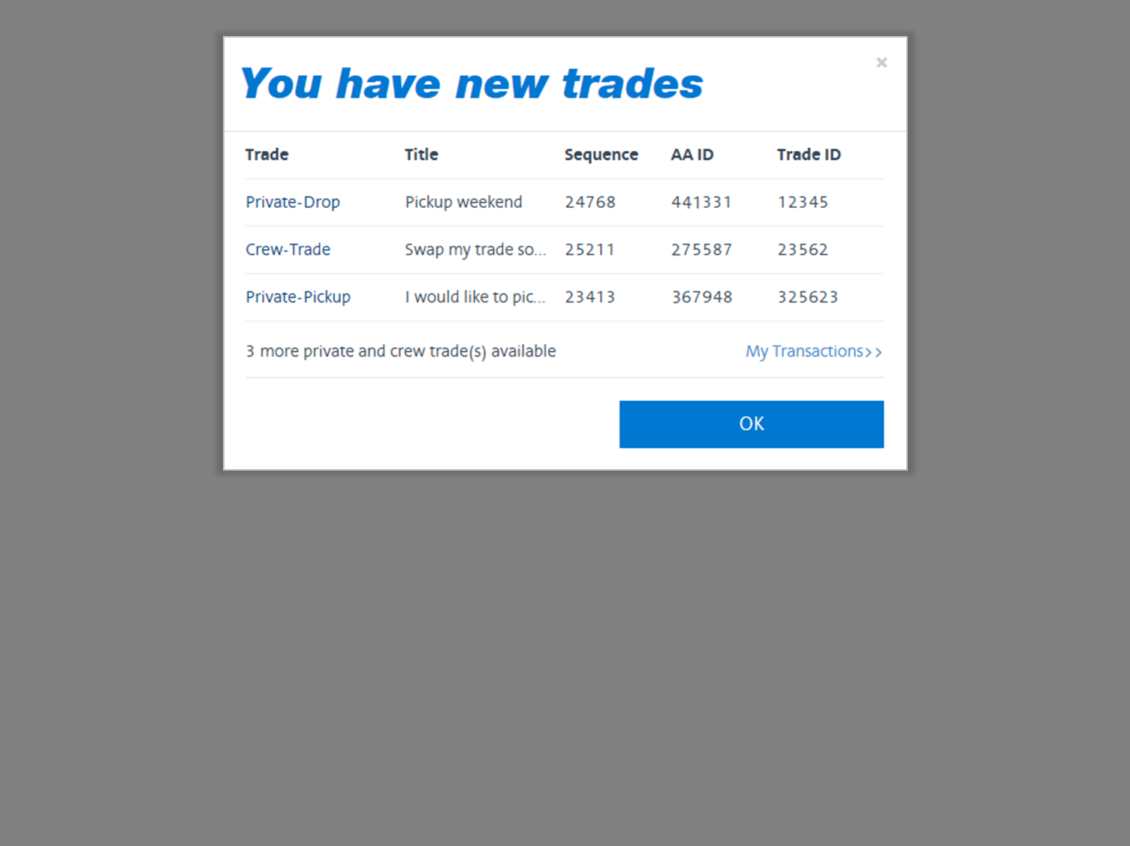
Takes you to ETB
Takes you to Crew Portal
Notes:
AUTO
There are several ways to access ETB
This is a view of what you will see when logging on to Crew Portal if you have any ETB activity.
Clicking OK takes you to Crew Portal and you can review your trades later
Clicking My Transactions will take you directly to ETB
#

Slide 8
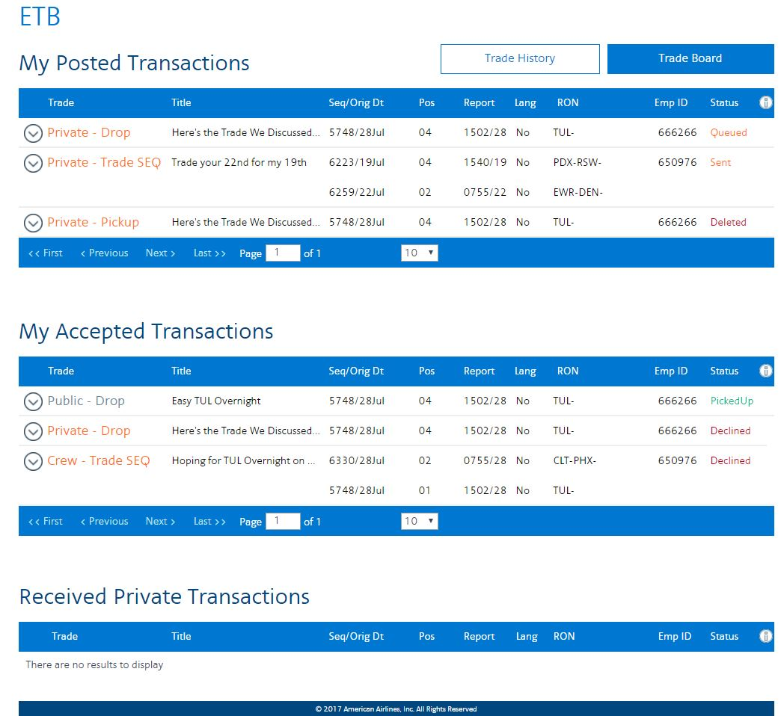
Notes:
AUTO
Here is a view of the My Transactions page.
My Posted Transactions provides detail on things you posted
My Accepted Transactions is a list of anything you have taken action on
My Received Transactions is where you will find pending trade requests, consider it your TO DO list
#

Slide 9
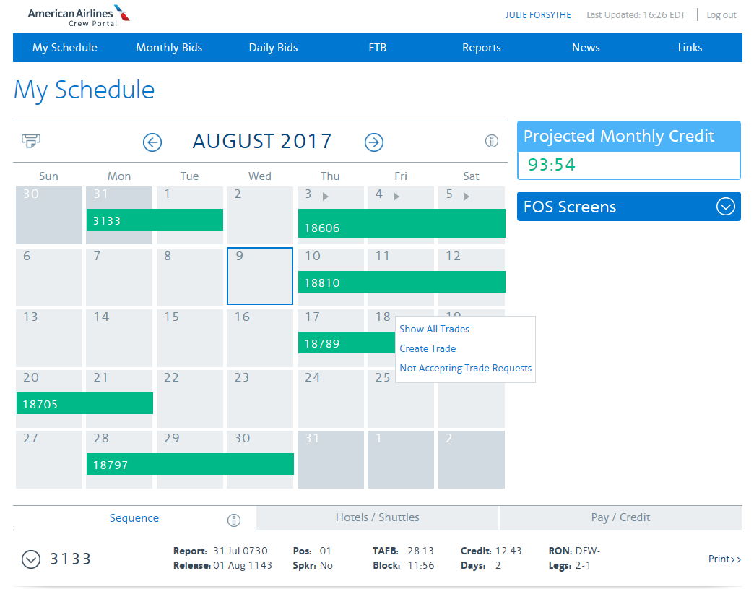
JANE STEW
Click to get to ETB
Click a date to see this pop up
Notes:
AUTO
A view of My Schedule on Crew Portal
Click ETB to go to the trade board
Click a date with a sequence to Show all trades, Create trade, or Not Accepting Trade Request (don’t click on the actual sequence)
If the date has no sequence you’ll only see Show All Trades
#

Slide 10
JANE STEW
Click to view personal info, quals and time display preference
Notes:
AUTO
This is a view of the ETB landing page
Unfiltered list defaults to most recent posts on top
# Click your name to check personal info and change Time Display Preference
#

Slide 11
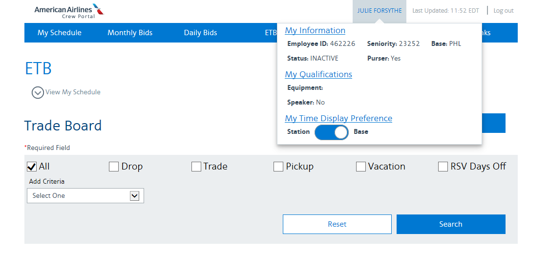
Jane Stew
123456
Notes:
AUTO
Use this toggle switch to change your preference
Time Display defaults to BASE
Once changed your preference is retained ON THAT DEVICE
#

Slide 12
JANE STEW
Select to sort/search
Each column is clickable for sorting
Click for sequence/pairing details
Notes:
AUTO
Click to see certain types of transactions (All, Drop, Pickup, Vacation, RSV Days off)
Column headings are clickable for sorting
Click on the down arrow to show more detail about the trip, including a crew list
#

Slide 13
Notes:
AUTO
These are screenshots of the sequence details you can view
First level shows report and release time, position, how many legs, and how much credit the trip is worth
Second level shows departure and arrival time for each leg, equipment type
Last level shows a crew list
#

Slide 14
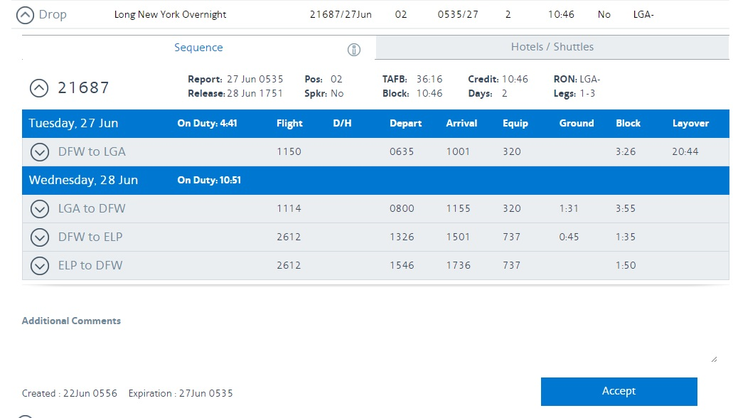
Notes:
AUTO
These are screenshots of the sequence details you can view
Second level shows departure and arrival time for each leg, equipment type
#

Slide 15
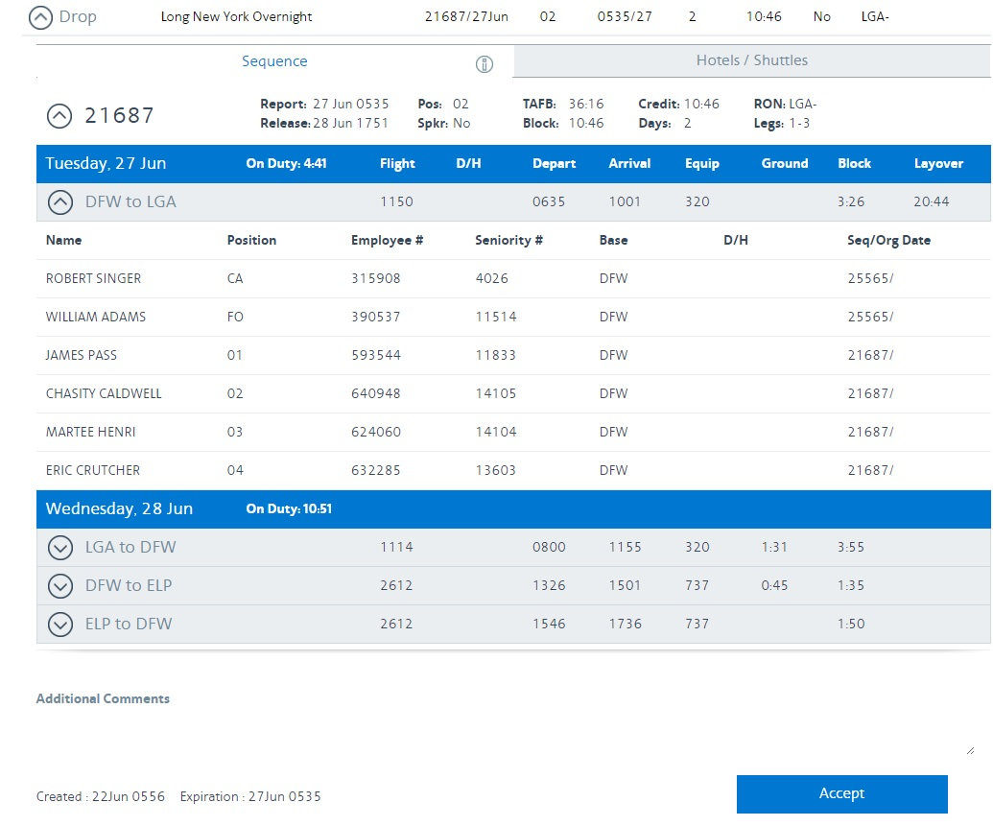
Allen Bravo
456789
Erin Foxtrot
123456
Jane Stew
345678
Sally Flyer
891234
Allen Tripp
789012
Peter Cruz
567890
Notes:
AUTO
These are screenshots of the sequence details you can view
Last level shows a crew list
#

Slide 16
JANE STEW
Click to view monthly calendar
Notes:
AUTO
Click the down arrow to view your monthly calendar
#

Slide 17
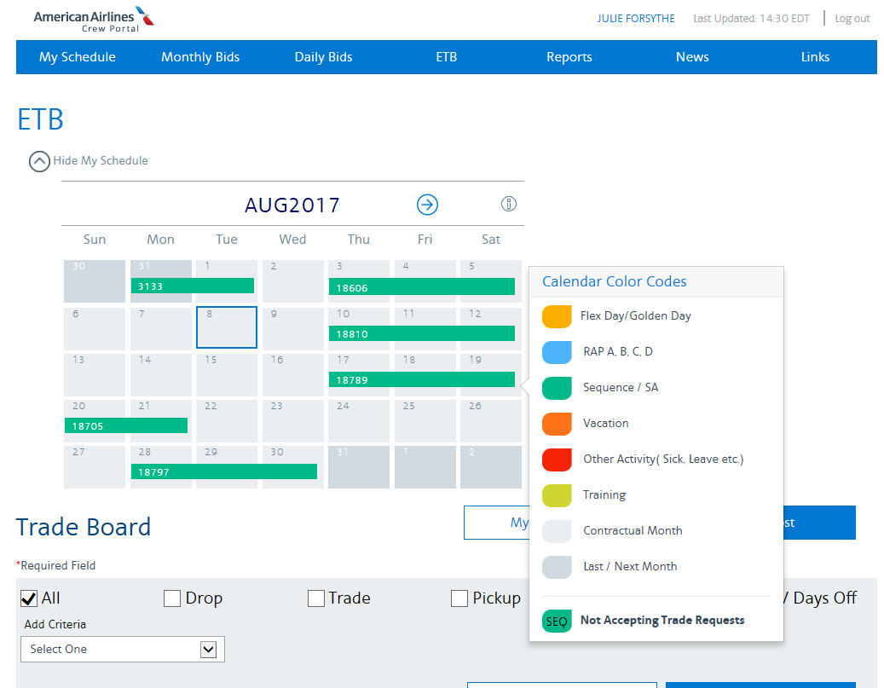
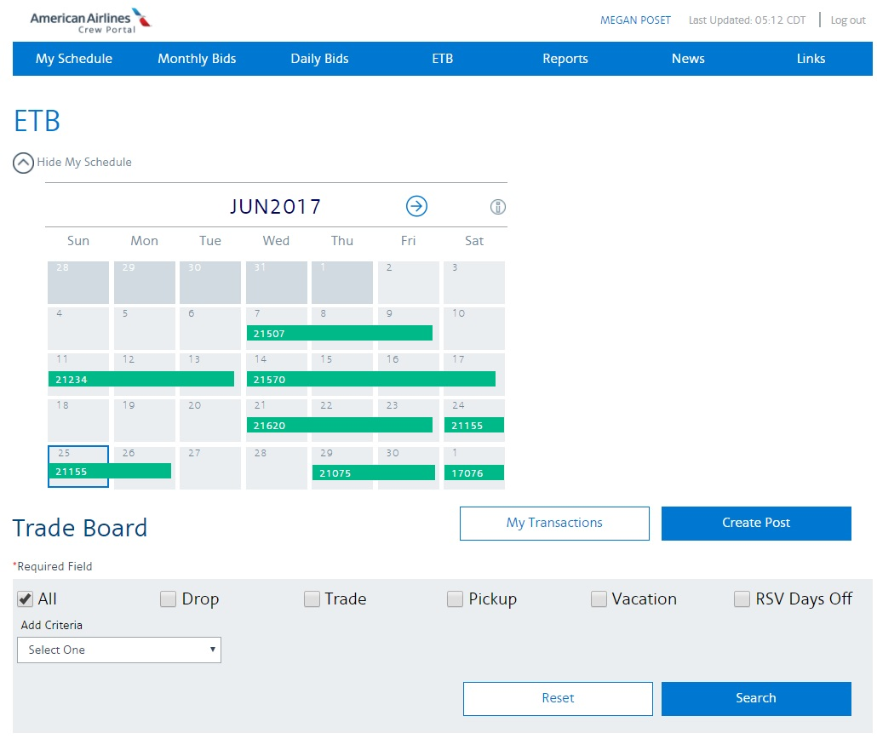
JANE STEW
Jane Stew
Click to change month
Click for information on the calendar
Click to close calendar view
Blue box around current day
Click to create a post
Hover to show report and release times
Notes:
Most of this information should be familiar from the Crew Portal demo
# Blue box is around the current day
# Click to show details about the calendar
# Click to change the month
# Hover over a sequence to see Report and Release times
Other than hovering, the calendar in ETB is not interactive
# Click on the up arrow to close the calendar
# Click on Create Post to create a post
#

Slide 18
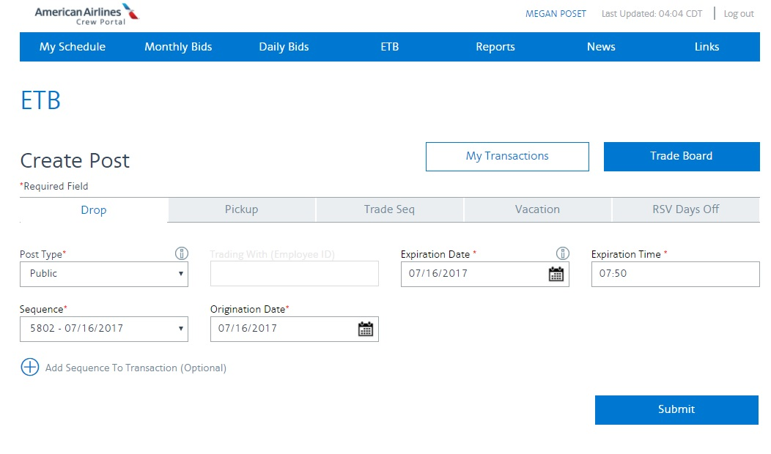
JANE STEW
ALERT : Drop is the default, ensure you choose the desired option
Choose what type of post
Choose Public, Private or Crew from the drop down menu
Expiration Date and Time default to the report time of the trip but can be changed
Choose desired sequence from the drop down menu
Click submit
ALERT : adding an additional sequence is a request to drop BOTH trips together
Notes:
Once on the Create Post page you will
# choose which type of post (Drop, Pickup, Trade Seq, Vacation, RSV Days off)
# Choose Public, Private, or Crew
Public is posted for anyone to see
Private is a posting to a specific individual
Crew is a posting to everyone on a particular sequence
# Choose a specific sequence
Expiration time and date automatically populate, but can be changed
Default time is report time for the trip
For instance you could change to 2200 the night before if you need to plan your commute. At 2200 your trip is automatically removed from ETB. No more surprises.
IMPORTANT if adding more than one sequence to a posting you are saying I want to drop or trade these trips TOGETHER, not as individual trips, useful if dropping as 2 for 1
# Click Submit
#

Slide 19
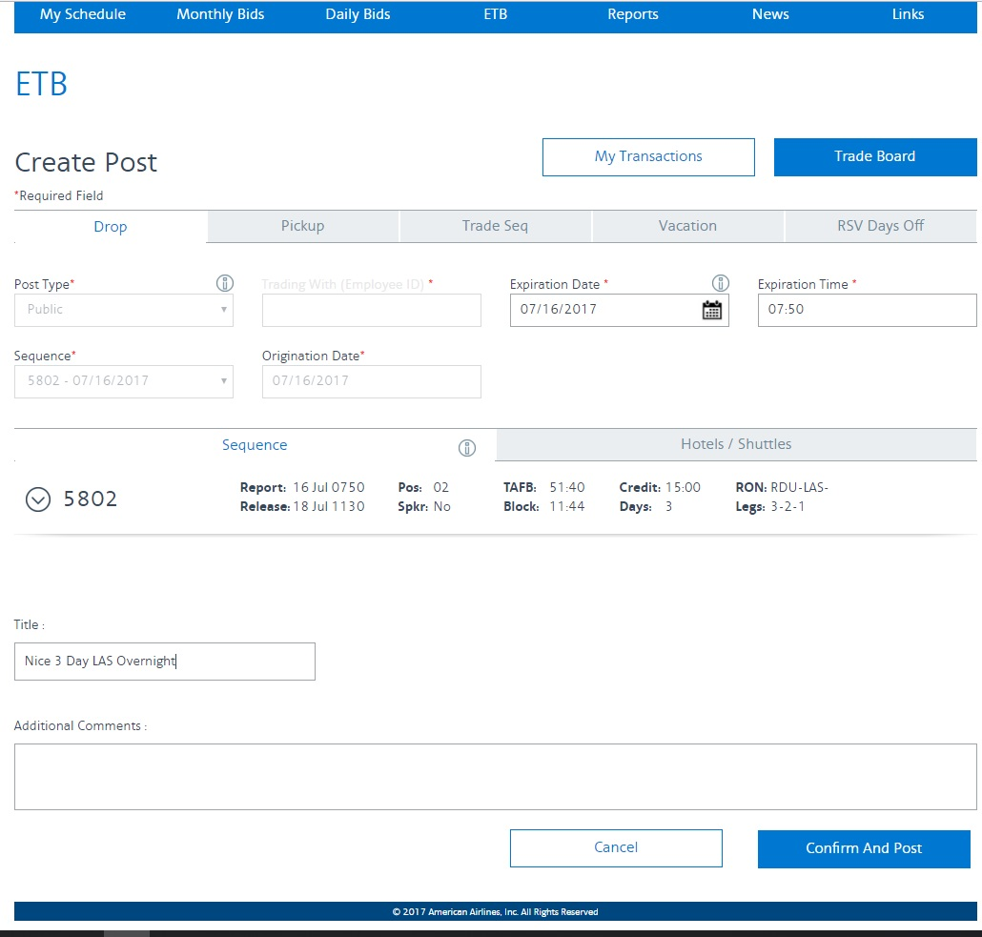
Add a title
Add comments
Click Confirm And Post
Notes:
AUTO
From this page you will add additional information to your post
Add a title, we strongly suggest keeping them short
If the title is too long, all of it won’t be seen on the main ETB page
Add comments, remember you can search the comments so use common terms
Commutable
Early return
Long layover
High time
Click Confirm and Post
#

Slide 20
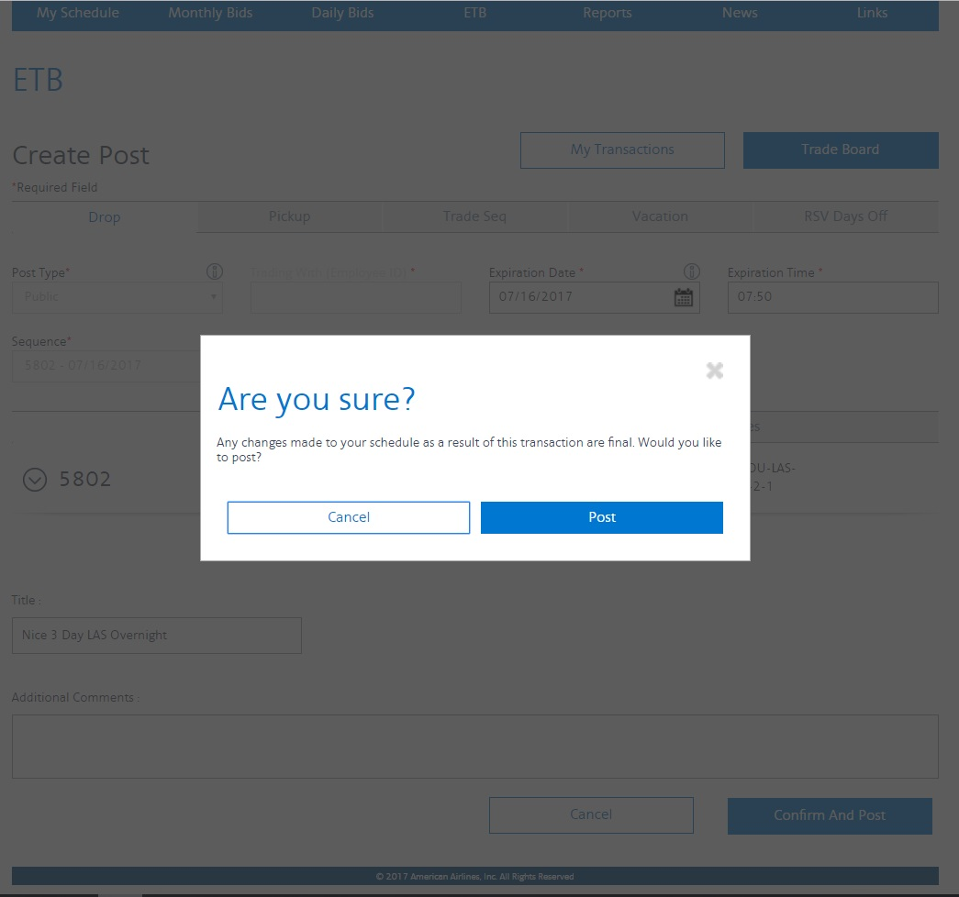
Click Post
Notes:
AUTO
Click Post
#

Slide 21
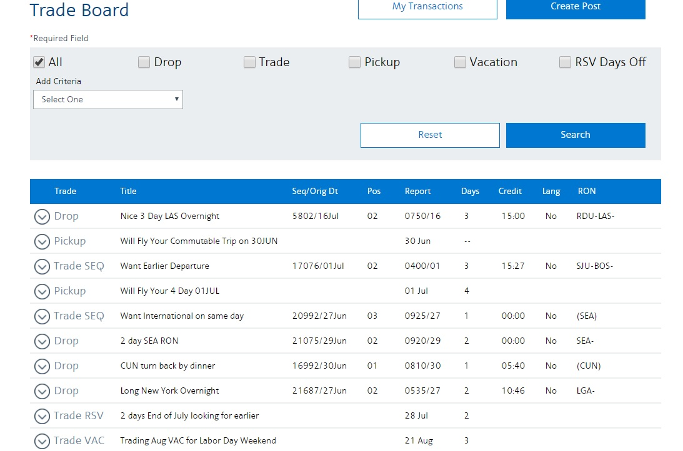
Notes:
AUTO
Here you can see your trip as it would appear after being posted
Default order is most recent posts at the top of the page
#

Slide 22
Deleting a post
Notes:
#

Slide 23
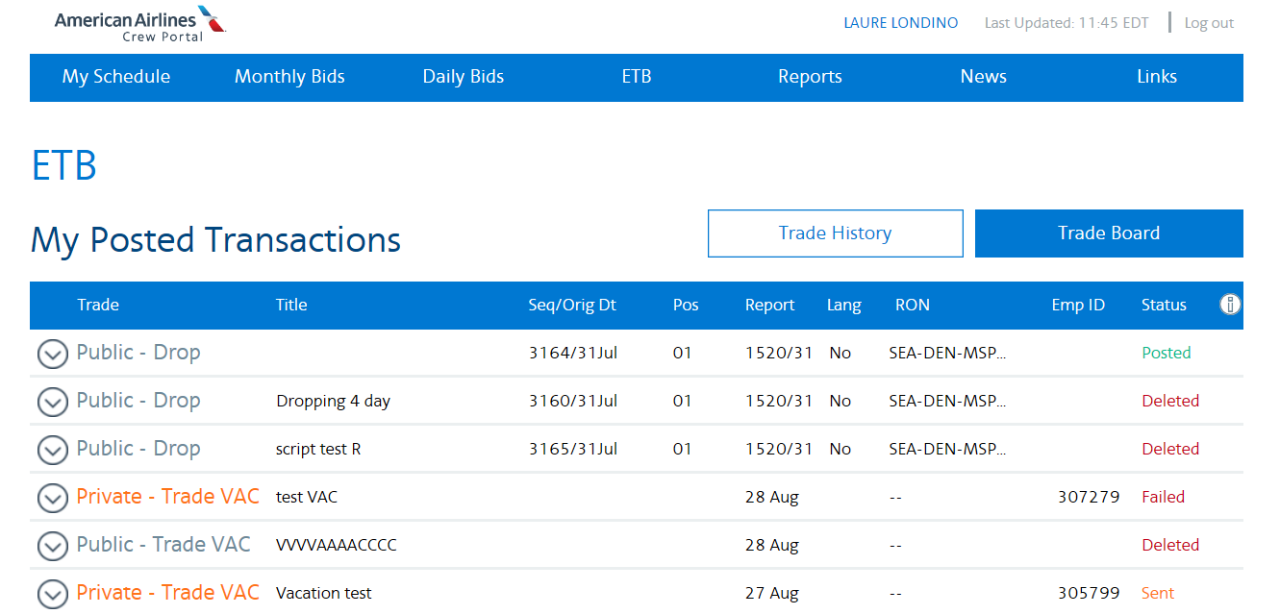
Jane Stew
Click down arrow
Notes:
AUTO
Two ways to delete a post
Search ETB for your post, or
View your postings by clicking My Transactions on the ETB home page, they will be listed under My Posted Transactions
Click the down arrow to see more information
#

Slide 24
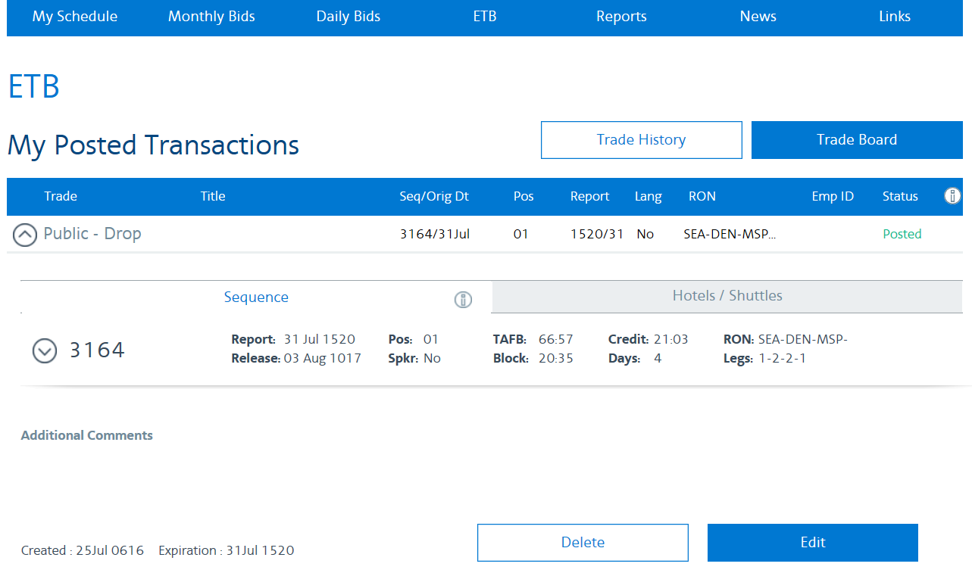
Click to delete
Notes:
AUTO
Click the delete button
#

Slide 25
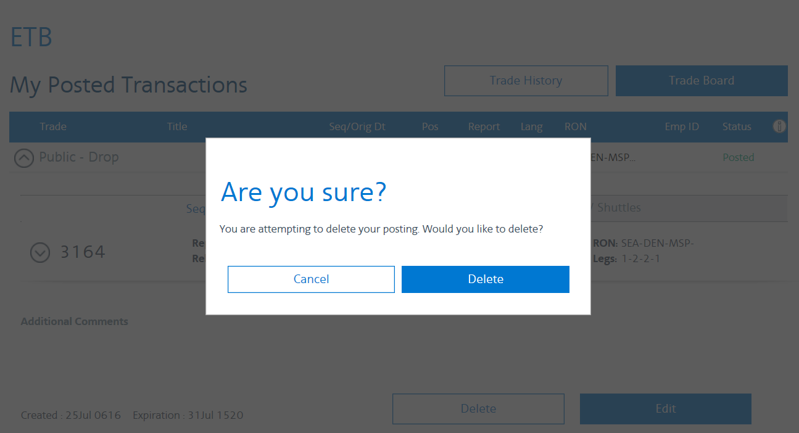
Click to delete
Notes:
AUTO
You’ll receive a pop up asking if you are sure, click Delete
#

Slide 26
Searching the ETB
Notes:
#

Slide 27
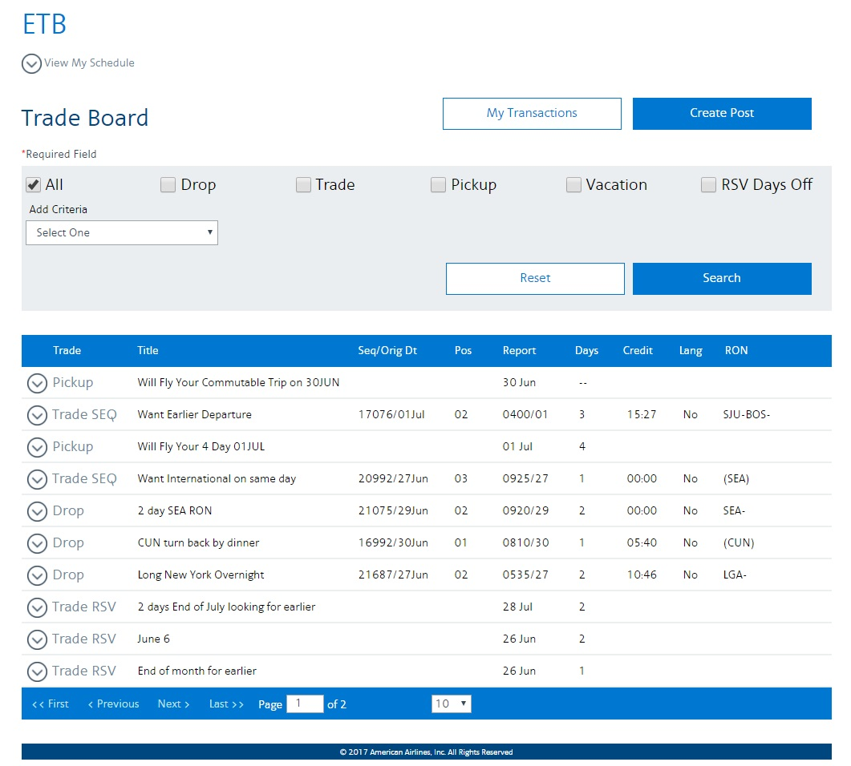
Check the box you want
Click Search
Click on any heading to sort
Add criteria to your search if desired
Notes:
AUTO
Robust sorting and searching capabilities
Check the box for the type of transaction you want
Drop
Trade
Pickup
Vacation
RSV Days Off
Add search criteria, multiple criteria can be chosen, and you can search and then add additional criteria
Click Search
Click the headings to sort, click again to reverse the sort
#

Slide 28
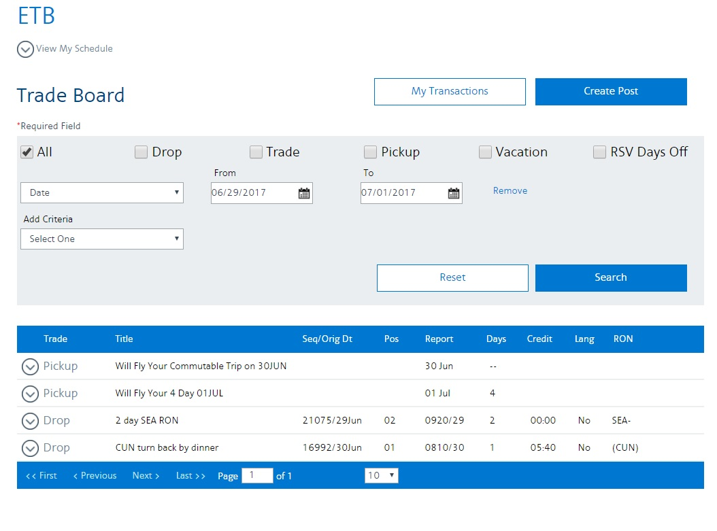
Notes:
AUTO
This is a view of the ETB sorted by date
#

Slide 29
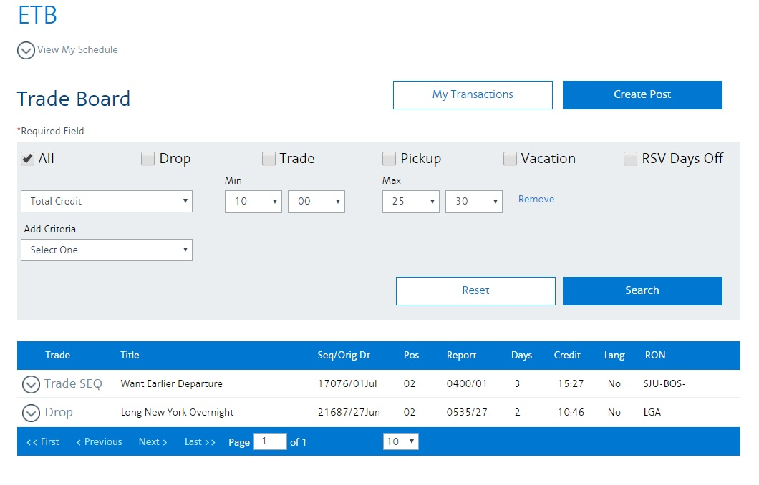
Notes:
AUTO
This is the ETB sorted by credit time
#

Slide 30
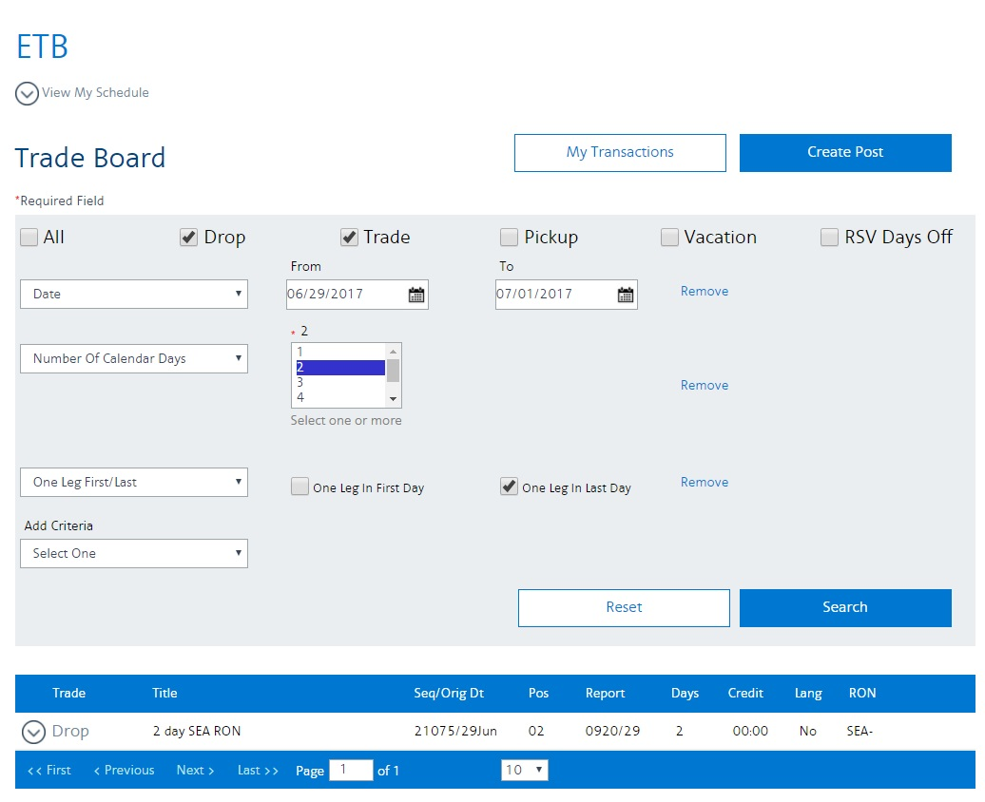
Notes:
This is a search using multiple criteria
# Drops and Trades
# Reporting on specific dates
# 2 day trip
# One leg in last day
#

Slide 31
Processing transactions
Notes:
#

Slide 32
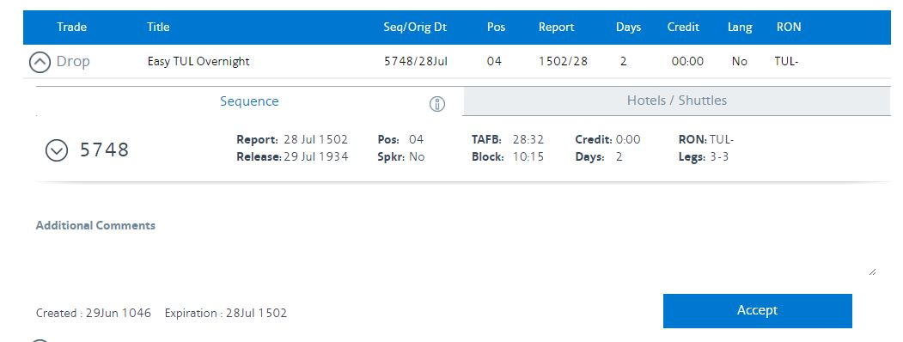
Click to accept the sequence
Notes:
AUTO
Processing a transaction only requires a few clicks
Find the trip you want to pick up by searching ETB
Click the arrow to see more details of the trip and the Accept button appears
Click accept if you want to pick up the trip
#

Slide 33
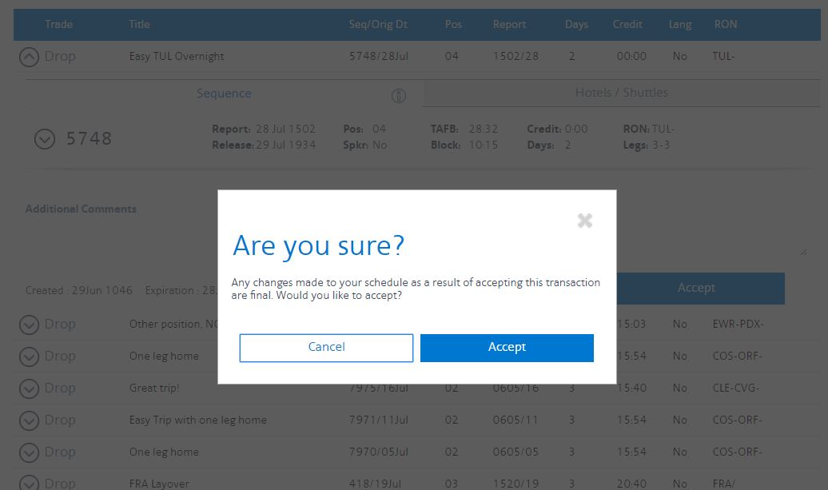
Click accept
Notes:
AUTO
You’ll receive a pop up
Click Accept if you are sure
#

Slide 34
Trading a Sequence
Notes:
Here is our scenario…you and a friend are flying together and discover that you can do a mutually advantageous trip trade. You will be posting the trade and your friend will be accepting the trade.
#

Slide 35
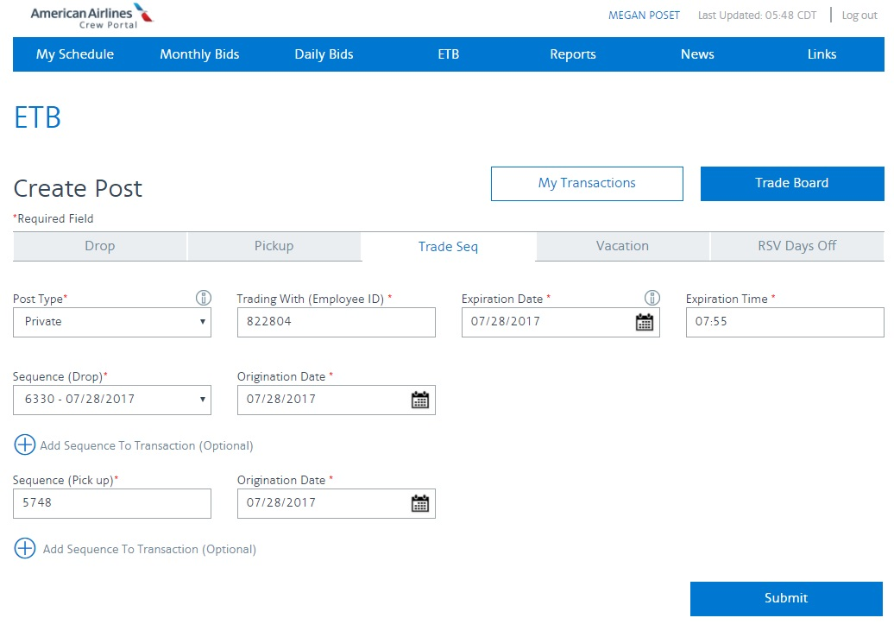
JANE STEW
Click Trade Seq
Choose Private
Add employee number
Choose a sequence
Click Submit
Add sequence number and date
Notes:
AUTO
Log on to ETB and click Create Post
Click Trade Seq
Choose private and add the employee ID of the person you are trading with
Choose your sequence from the drop down menu
Add the other FA sequence information
Click submit
#

Slide 36
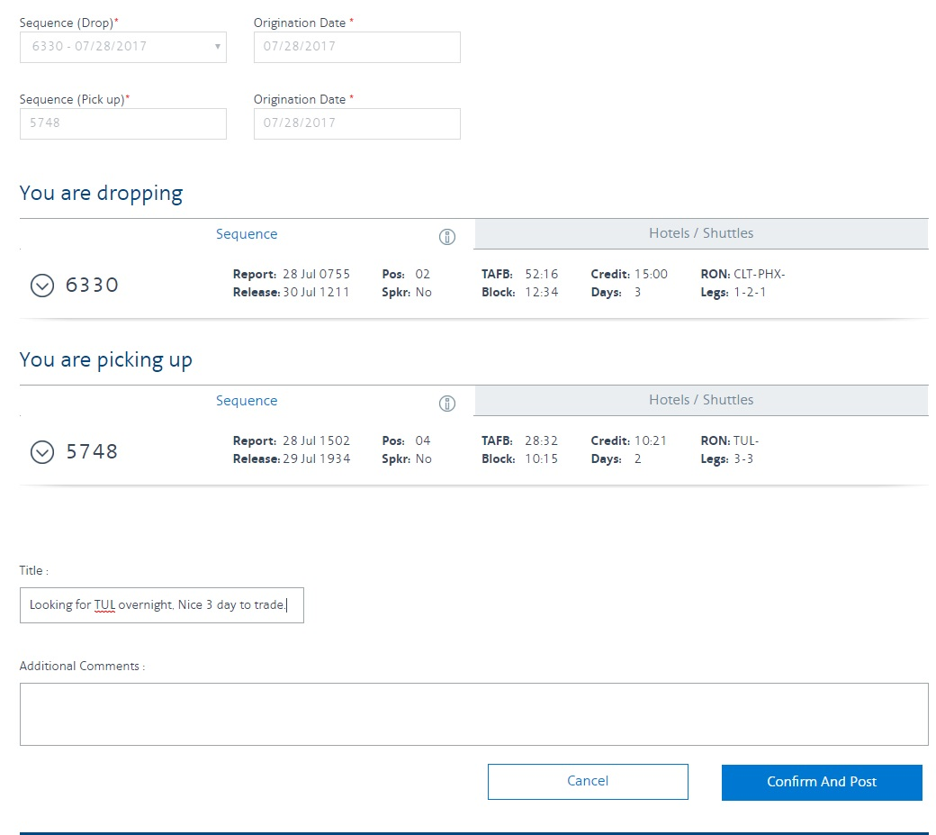
Add a title
Add comments
Click Confirm and Post
Notes:
AUTO
Add a title
Add comments
Click Confirm and post
This posting is then sent privately to the other FA to accept
#

Slide 37
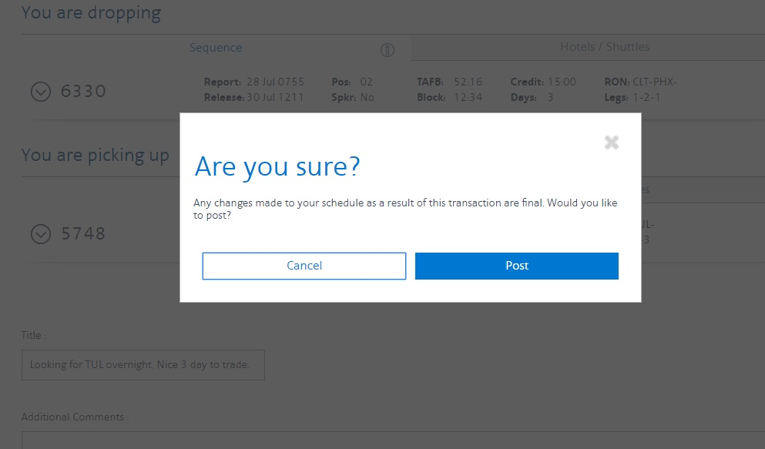
Click Post
Notes:
AUTO
You’ll receive a pop-up message
Click POST
#

Slide 38
JANE STEW
Notes:
AUTO
You can see the posting has been sent and needs to be accepted by the other flight attendant
#

Slide 39
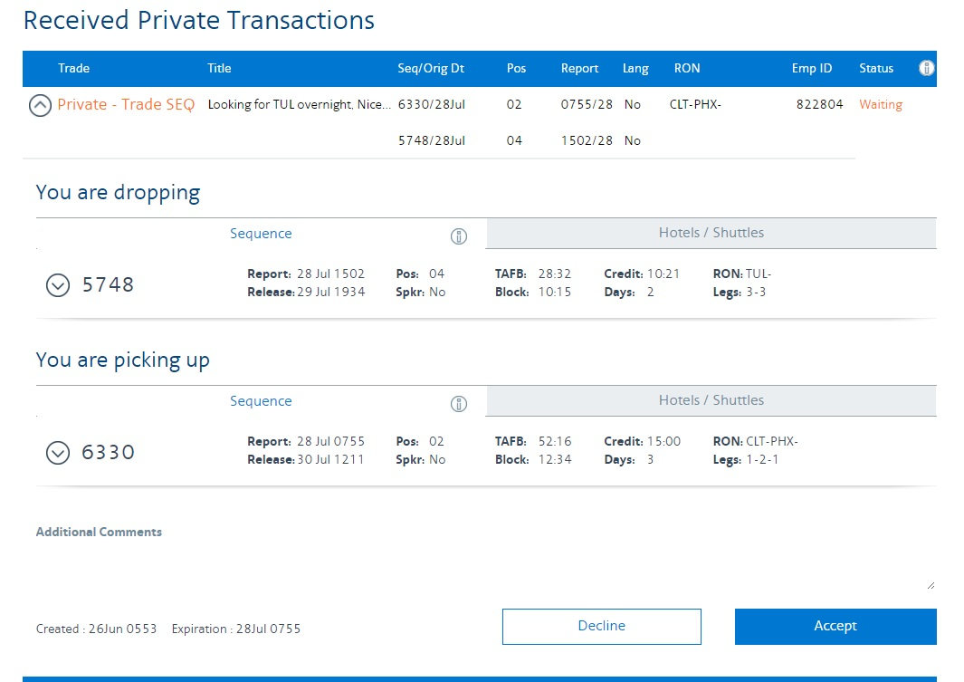
Click to accept
Notes:
AUTO
This is a view of what the other FA will see when looking at their transactions page
Click the down arrow to open up details
Click accept to process the trade
#

Slide 40
Traded
Notes:
AUTO
Here you can see the transaction shows as traded
#

Slide 41
ONE messages

Slide 42
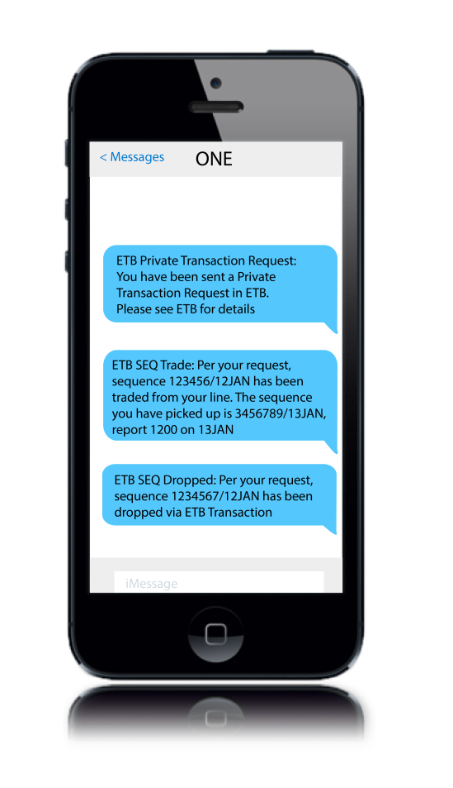
ONE messages
Received anytime your schedule changes
Received anytime you have private or crew requests
AA.com email
Personalize your preferences to include CCI and text messaging
Notes:
ONE message for private request
ONE message for acceptance
ONE message NOT RECEIVED for declined
ONE will be discussed in trending topics

Slide 43
Credit Window
Notes:
#

Slide 44
ETB and your Credit window
ETB transactions do not affect your credit window
ETB transactions do affect your MAX
Notes:
Discussed in depth by JSIC
ETB pickups are unlimited
Non-PBS can drop to zero using ETB
PBS bases may drop to 40

Slide 45
Vacation Rules
Notes:
ETB IS PROGRAMMED FOR JCBA VACATION RULES

Slide 46
ETB and vacation trades
ETB can be used to post, search and process vacation trades
PBS – cannot create an additional period of 1,2 or 3 days
Non-PBS –blocks must be the same size, but not same number of days
Notes:
One block of 1,2 or 3 days (per year...calendar year, or fiscal VC year?)
Due 5TH of month
For non-PBS bases vacation trades are submitted through ETB but will be manually processed by the base planner, FA notified by HI6
ETB IS PROGRAMMED FOR JCBA VACATION RULES

